Slide 1
Public Policy Research Funding Scheme: Experience Sharing
CHEUNG, Kwok Wah Ph.D.(Lon)
Dean of Education and Languages, OUHK
Member, PPR Funding Scheme

Slide 2
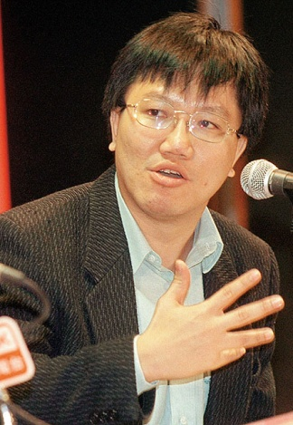
About KW
Lecturer, Assistant Professor, Associate Dean, Faculty of Education, HKU
(1992 – 2009)
Principal Assistant Secretary of Education (Curriculum Development), EDB
(2009 – 2013)
Dean of Education and Languages, Open University of Hong Kong
(since Feb 2013)

Slide 3
Why changed from RGC to CPU
Previously, only UGC institutions eligible, now self-funding tertiary institutions and policy think tanks can also apply
RGC review processes tend to encourage pure academic driven research topics, CPU wants to encourage more research projects informing policy initiatives
Hence, FDS and PPRFS are different

Slide 4
Indicative Research Areas & Strategic Themes
land and housing
poverty and ageing/retirement protection
political development and governance
external economy
social issues
economic development
environmental protection
21 indicative research areas

Slide 5
Strategic Public Policy Research Funding Scheme
(a) one belt one road;
(b) cross-strait three regions studies;
(c) national identity;
(d) big data;
(e) smart city;
(f) impact of social media and education; and
(g) impact of new technology on modern life and industry.

Slide 6
Who are the PPR Reviewers?
Assessment Panel members appointed by CPU
Academics from UGC institutions and self-funding institutions
Experienced researchers and policy advoctaes
External reviewers
Local and overseas academics
Related policy Bureaus

Slide 7
Duration of Granted Projects (As of Early September 2016)
Total : 90 Projects
*Original Duration as granted.
Notes:
Original Duration as granted.

Slide 8

Duration of Granted Projects (As of Early September 2016)
Original Duration* | Number of Projects | Percentage (%)
6 | 2 | 2%
8 | 1 | 1%
9 | 10 | 11%
10 | 1 | 1%
12 | 57 | 63%
15 | 5 | 6%
16 | 2 | 3%
18 | 4 | 4%
22 | 1 | 1%
24 | 7 | 8%
 | 90 | 100%

Slide 9
Granted Funding Amount (As of Early September 2016)
Average | HK$ 538,300
Median | HK$ 518,262
Maximum | HK$ 1,636,653
Minimum | HK$ 157,895
Average
Notes:
project costing over HK$ 1 million: granted

Slide 10
Breakdown on Projects Granted to Each Institution (UGC Funded Institutions)
Eligibility Criteria | Institutions | No. of Granted Project
Eight degree-awarding institutions funded by the University Grants Committee (UGC) | City University of Hong Kong | 13
 | Hong Kong Baptist University | 4
 | Lingnan University | 4
 | The Chinese University of Hong Kong | 9
 | The Education University of Hong Kong | 8
 | The Hong Kong Polytechnic University | 20
 | The Hong Kong University of Science and Technology | 4
 | The University of Hong Kong | 22
 | Total: | 84

Slide 11
Breakdown on Projects Granted to Each Institution (Self- Financing Institutions)
Eligibility Criteria | Institutions | No. of Granted Project
Publicly-Funded and Self-Financing Institutions | Hang Seng Management College | 1
 | The Open University of Hong Kong | 1
 | Total: | 2

Slide 12
Breakdown on Projects Granted to Each Think Tank
Eligibility Criteria | Institutions | No. of Granted Project
Think Tanks | Dashun Foundation | 1
 | One Country Two Systems Research Institute | 1
 | Hong Kong Academy of Engineering Sciences | 1
 | Civic Exchange | 1
 | Total: | 4

Slide 13
Elements of successful proposals
Important policy concern (not necessarily in support of existing government policy)
Research plan clear, practical and cost effective
Sound academic rationale

Slide 14
FAQ
Is support from policy bureau important?
Can I buy out my teaching?
Is it still as competitive as RGC?
Is the duration of research project an issue?
Further information: http://www.cpu.gov.hk/en/public_policy_research/index.html

Slide 15
Thank You !!!

